Slide 1

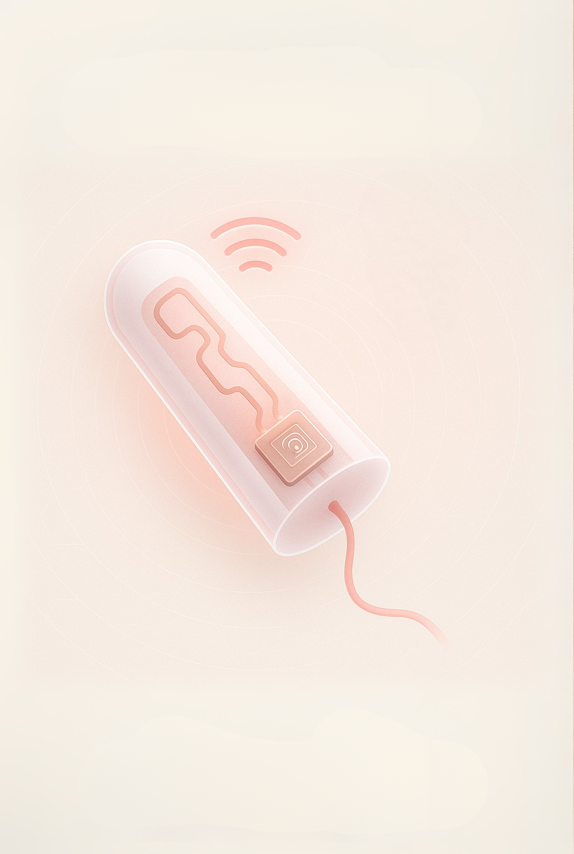




Innovating Feminine Health
Smart Tampons Technology
Transforming menstrual health with our innovative IoT solutions and empower users with real-time insights.
sense

Slide 2
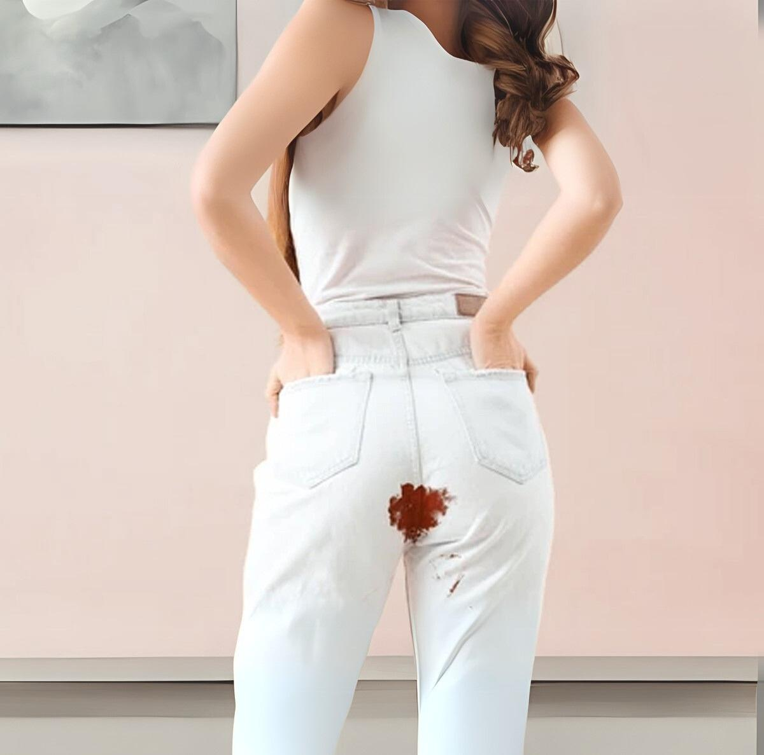





Why Today’s Tampon Fails Users
Saturation Uncertainty
No real-time data on capacity
Data Blind Spot
Missing critical health insights
Extra Bathroom Trips
Unnecessary checks disrupt day
Health Risk
TSS potential with prolonged use
sense

Slide 3

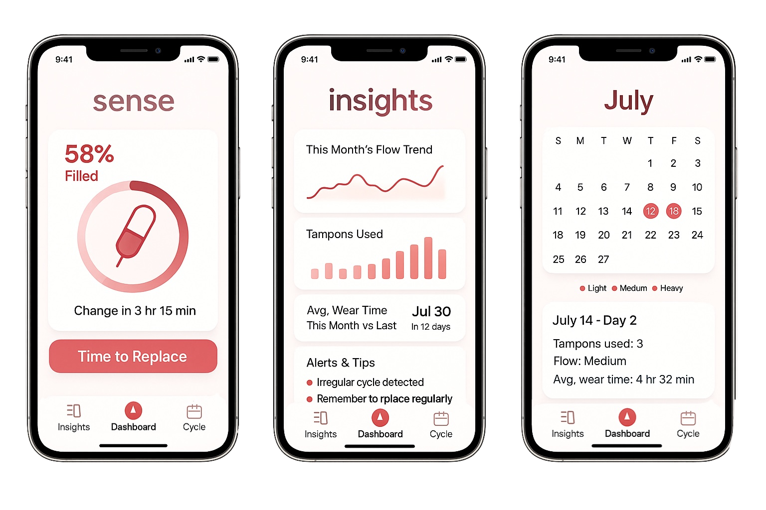
sense
User Experience
Automatic Documentation
Real-time Tracking
Insights
effortlessly track historical menstrual data without manual input.
Track your cycle and flow with instant notifications.
Track your flow trends easily and accurately.

Slide 4
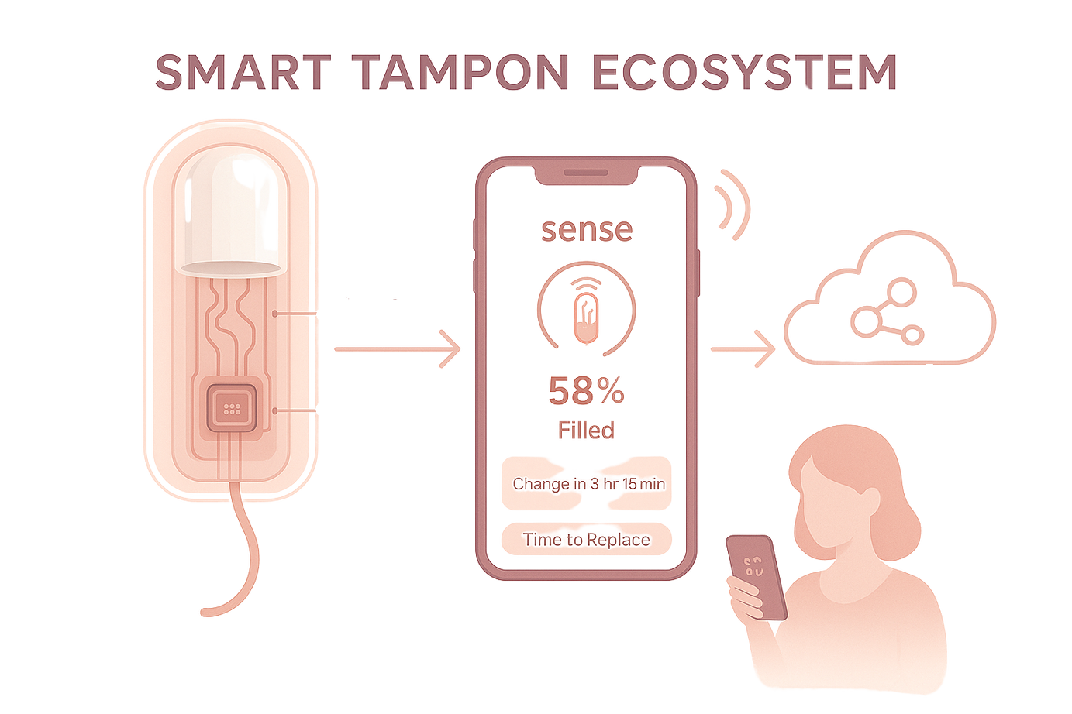
Practical Path - From Idea to Pilot
Electrical-property sensing
Converting Algorithm
Paper-thin IoT Tag
Paper-thin IoT Tag
Embedded seamlessly tampon
POC in progress
sense

Slide 5






Competitor Analysis
Product | Form-factor & Offer | Real-Time Saturation Sensing ? | Auto Cycle Tracking ? | Leak Prediction Alerts ? | Disposable ?
Regular Tampons | Disposable cotton/rayon tampon, passive absorption
 | Disposable tampon embedded with IoT sensor. real-time saturation alerts via smartphone
sense

Slide 6
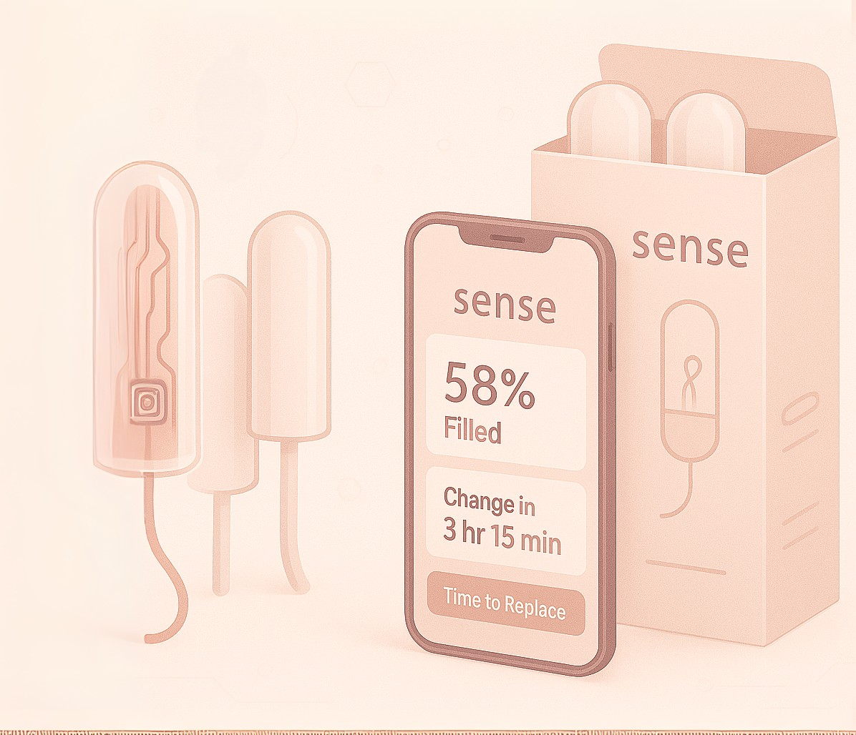



Business Model Overview
Develop Core Tech -prove safety and performance
B2B Launch
Build user base and data
IP Transfer
Patents, software, clinical data
sense

Slide 7

Business Model Milestones
Strategic Partnership
FDA
Alliance with tampon brand
Phase Clinical
Compile & file 510(k)
MVP
Safety & efficacy trial; refine sensor + app
Q4 2027
Prototype
Full-scale design & costed BOM
Q4 2026
Validation PoC
BLE link + mini-app with tracking algorithm
Bench tests
Sensor model set
Q2 2026
Q3 2025
Q4 2025
Q2 2025
sense

Slide 8
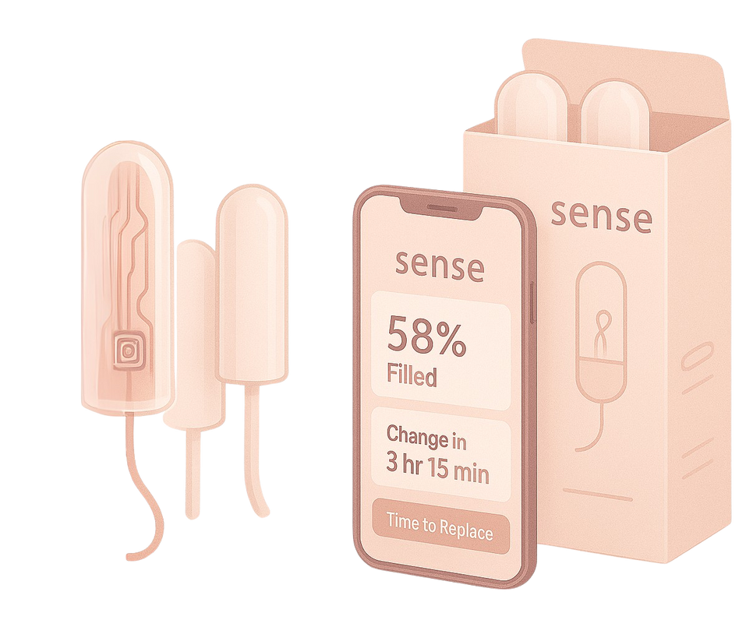
Market Size Insights
$6.4B
$9.4B
World wide combined Tampons revenue.
World wide combined Tampons revenue. 2030
Focused on acquisition by a key players:
P&G, Kimberly-Clark, Edgewell, or Kenvue-
who together dominate the market.
sense

Slide 9
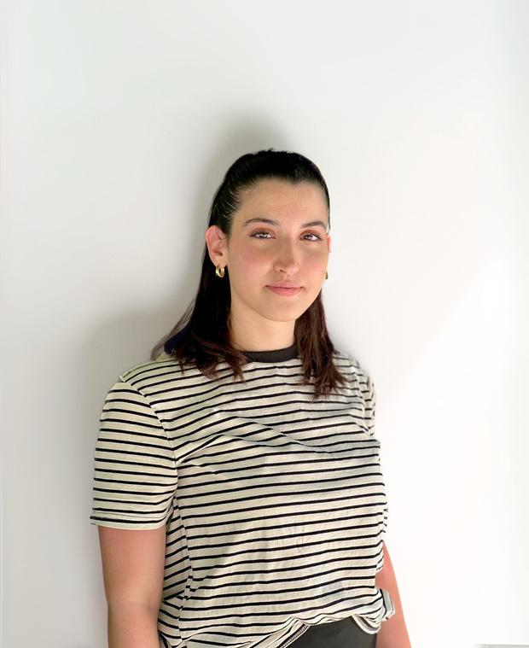
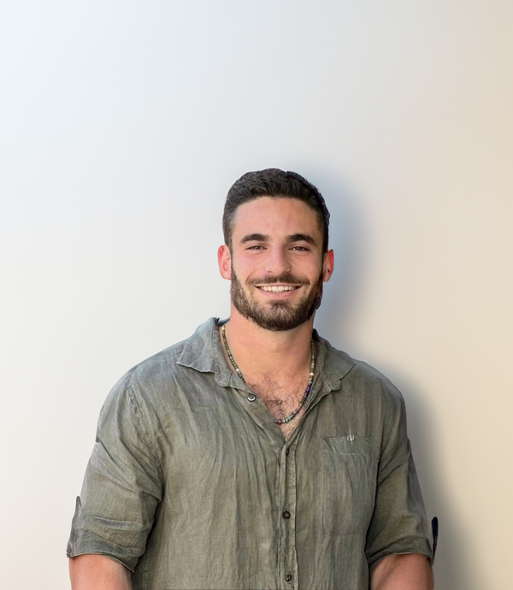
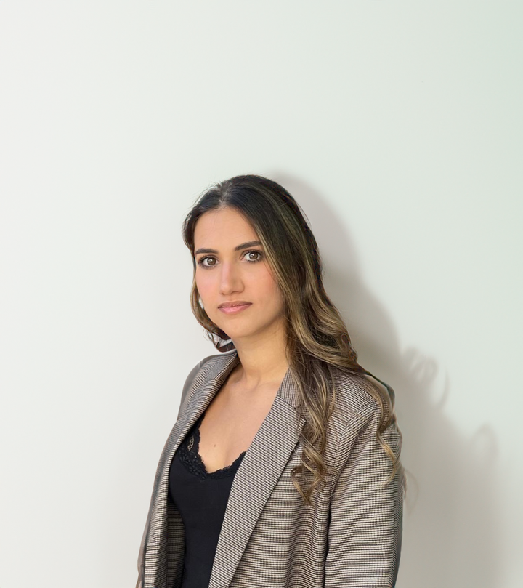

sense
Our Team
Adar Shamir
Dan Israel
Thelet Shevach
VP Engineering
CEO
CTO
Third year B.Sc Electrical Engineer
Second year honor student,
B.A Business Administration and B.A Psychology
Third year B.Sc Computer Science

Slide 10

Thank You!
Contect Us
Thank you for your time and interest.
For questions or more information, don’t hesitate to reach out.
We look forward to collaborating and revolutionizing feminine health—together.
Email
SenseTampons@gmail.com
Thelet Shevach
Dan Israel
+972 546964547
+972 543040105
Adar Shamir
+972 523022522
sense

